Slide 1
2013 Global SMB Segment Plan Prepared for Jerri-Ann Meyer

Slide 2
Agenda
The SMB Market
Assessment of Current SMB Business
2013 Plan
Partner Eco-system
How do we market?

Slide 3
The SMB Market

Slide 4
SMB Snapshot
62M
20%
75^{%+}
30%
WORLDWIDE
AND GROWING ARE VIRTUALIZED
USING VMWARE
SMB ATTENDEES
AT VMWORLD
Notes:
SMB Snapshot
Regardless of size customers want the same things from IT solutions
Only 3 Spotlights here at Vmworld – of all the products and technologies VMW has to talk about, why did we choose to dedicate one to SMB?
First, Because SMBs are important -- a major presence globally, a major opportunity for virtualization, and a major presence here at Vmworld
27M+ Number of Small Businesses in the US (SBA)
64% of net new jobs over the past 15 years generated by SMBs
99.7% of all employer firms in US are SMBs
Second, Because SMBs have some unique needs, and require unique solutions. While SMBs want IT to deliver the same core attributes as larger companies, the form those solutions take needs to be tailored to SMBs. VMware is committed to bringing quality innovation to the SMB market, to provide the enterprise-class solutions it is known for, in a format that works well for smaller IT shops. We want to share our approach, and our solutions.
62M SMBs worldwide (DNB)
80% are using VMware based on Spiceworks study
=== === ===
Think about showing stats and then filling in with images as the slide builds
http://www.microbiz.org/small-business-statistics/
http://www.idc.com/getdoc.jsp?containerId=IDC_P16244
27M+ Number of Small Businesses in the US (SBA)
64% of net new jobs over the past 15 years generated by SMBs
99.7% of all employer firms in US are SMBs
Half of all private sector employees in the US are employed by SMBs

Slide 5


What’s Unique to SMBs
LEAN IT STAFF
LACK OF TIME
TIGHT BUDGETS
Notes:
So what is unique to SMBs?
These major constraints: staffing, time and budget.
IT Staffing scales with the business, but scope of responsibility remains the same
Example projects
Larger SMBs have avg IT staffs of 10-15. Virtualization, typically 2 people
Smaller SMBs have avg IT staff of 5-10. Virtualization, typically 1 person
Time directly flows from the staffing level. Challenge to build technical depth on so many fronts.
This is also why we see somewhat slower adoption in SMB, with a range of profiles. There are the innovators like you who adopt early; there are the Curious who are still on the fence
This is in part why when SMBs do virtualize, they tend more or all at once
Budgets – Budgets are tight, and need to have a solid return. Fortunately this is a place virtualization is strong, so of the three it is the least constraining. Nevertheless important.
Implications to VMware:
Deliver comprehensive solution bundles
Make it easy to deploy and manage
Price attractively
----- Meeting Notes (8/23/12 15:56) -----

Slide 6


Technology Implications
a
BUSINESS CONTINUITY
WORKLOAD & WORKFORCE MOBILITY
AUTOMATED MANAGEMENT
COMPREHENSIVE & INTEGRATED SOLUTIONS
Notes:
Implications to VMware:
Deliver comprehensive solution bundles
Make it easy to deploy and manage
Price attractively

Slide 7
SMB Growth Rate 2011 - 2016
IDC WW SMB IT Spending Forecast IDC | CAGR (2011-2016) | 2011 | 2016
 | 6.5% | $507.6B | $695.4B
North America | 4.7% | $143.0B | $180.2B
Latin America | 9.5% | $36.5B | $57.4B
Western Europe | 4.6% | $151.3B | $189.8B
CEMEA | 8.2% | $53.7B | $79.7B
APAC | 8.9% | $123.1B | $188.2B
All company size sub-segment forecasted to have around 6.3%-6.7% CAGR (2011–2016)
Source: IDC, March 2012
Notes:
CAGR - 1-99 employees: 6.5%, 100-499 employees: 6.3%, 500-999 employees: 6.7%

Slide 8
SMB Segment Total Addressable Market – Market Segment not Sales Coverage
Customer Segments
Whitespace vs. Customers
Enterprise Marketing
Enterprise
5,000+
3,867 Accounts
4,988 Accounts
6,025
Accounts
17,068 Accounts
22,328 Accounts
46,845 Accounts
Commercial
1,000-4,999
Medium Business
MB 500 – 999
21K accounts
Customers – 6.4K (30%)
Whitespace – 14.7K
26K accounts
Customers – 6.3K (24%)
Whitespace – 20.1K
57K accounts
Customers – 2.2K (4%)
Whitespace – 54.7K
SMB Marketing
Small Business
SB 100 – 499
176K accounts
Customers – 23.2K (13%)
Whitespace – 153K
236K accounts
Customers – 24.5K (10%)
Whitespace – 211K
420K accounts
Customers – 6K (1.5%)
Whitespace – 414K
Very Small Business
1-99
26.4M accounts
Customers – 50.2K (.2%)
Whitespace – 26M
39.2M accounts
Customers – 57.8K (.1%)
Whitespace – 39M
8.2M accounts
Customers – 10.8K (.1%)
Whitespace – 8M
Consumer
1
AMER
EMEA
APJ
Source: Marketing BI, September 2012
Note: # of accounts indicate companies in D&B WorldBase in Global Ultimate; Customers are vSphere customers
Notes:
Whitespace 73,867.50 Customers 187.40
Slide numbers are from region:
customer counts from global ops: based on market units minus fusion and workstation
2011 EMEA total VSB is 49747, total SB is 22385, MB 6627
NORAM: 6097 for medium, 20421 for small, VSB 44753
Data from 3 year plan deck
Addressable Market
62M
# of SMB companies per DnB globally
Not all of them are addressable
5M
# of contacts in VMware Database
Not all are contactable / marketable
160k
# of paid VMware SMB customers
Excludes free hypervisor customers

Slide 9
Top IT Priorities for SMBs
BCDR, consolidation/virtualization remains a top 5 priority
Security increases in importance so we need to Include security in our message
Explore opportunities with BI vendors for new route to market
Top 5 IT Priorities
Business continuity and disaster recovery
Business Intelligence
Security
Server consolidation
Virtualization
Q. Which of the following initiatives are likely to be your IT organization top technology priorities over the next 12 months?
% responded critical/high priority
Top IT Priorities by different geo
Matured Countries (US, Canada, UK, France, Germany, Australia/NZ) | Emerging Countries (Russia, Brazil, Mexico, Japan, China, India, Philippines, Indonesia, Malaysia, Singapore)
1. Use business intelligence | 1. Upgrade security
2. Upgrade BCDR | 2. Upgrade BCDR
3. Consolidate/virtualize | 3. Use business intelligence
Brazil & Mexico – 73% say server consolidation is critical/high priority
Source: Forrsights Budgets And Priorities Tracker Survey, Q2 2012

Slide 10
What Does the Current VMware SMB Business Look Like?

Slide 11
Mission 0: Transaction Business FY13Q1 Executive Summary
Q1 Highlights
Major Strategies
VSOM launched (GA in mid March)
PEX and PEX on tour
“People Like You” announced to channel
NetApp Test Drive (VSOM) launched
EMC EUC VSPEC announced to partners
Launched Sales Bytes
Strategies | Status
Increase adjacency penetration | Non-vSphere bookings 14% up
Drive net new customer acquisition | Continues to decline
Utilize web for low-touch transactional sales | Benchmark before re-design
Engage & Excite long tail of our partner community | # partners up but ASP down
Trends/Findings
Q2 Plans In Flight
Sub $100K, non-ELA business is challenged
Non-vSphere increased to 34% in bookings
Early results on vCloud Suites, vSOM, and Essentials UK pilot look promising
Lower ASP (especially in SMB customers)
New customer acquisition from OEM declining (4% decline in x86 server shipment YoY in Q4 - IDC)
MSFT increasing market share (1.4% up) in newly virtualized servers (Spiceworks)
“People Like You” campaign launched in April in NORAM & English-speaking EMEA
EMEA and APJ international launch in Mid-May & LATAM in June
HP/VMware and Dell/VMware campaigns are under development and should launch in May
Value Added Distribution (VAD) Pilot in plan
Customer life cycle pilot, and renewals (cross-sell/upsell)

Slide 12
13Q1 General Business Average Deal Size
Confidential
Please do not distribute
New SMB customers ASP decreased -24% YoY; expanding customer base into price conscious segment
AMER Very Small SMB showing a large YoY decline from $3.4K to $2.6K
Existing customers saw an increase in ASP in AMER in Medium and Small SMB segments
Commercial segment is purchasing higher edition of vSphere (48% of units are STD and above whilst in the SMB segment it is 40%)
Sales focus on larger deals and ELA’s has led to a higher ASP
 | New Customers ($K) |  |  |  |  | Existing Customers ($K)
 | 12Q1 | 12Q4 | 13Q1 | YoY | QoQ | 12Q3 | 12Q4 | 13Q1 | YoY | QoQ
SMB | $3.4K | $3.0K | $2.6K | -24% | -14% | $6.8K | $8.1K | $6.5K | -10% | -11%
Commercial | $8.9K | $9.6K | $8.8K | -1% | -8% | $11.8K | $16K | $14.8K | 25% | -8%
NOTE: Average Deal Size = License bookings per customer in a quarter
Notes:
The % mix of units at ESS/ESS+ is flat YoY but ESS makes up a larger % of it.

Slide 13

SMB Market Share
Confidential
Please do not distribute
VMware maintains overall market share in SMB globally
MSFT gaining more share in newly virtualized servers in sub 100 employee segment
Source: Spiceworks, March 2013
Est. Global SMB Server Virtualization Market Share
n = 235,508 devices
n = 1,108,511devices
-0.7%
in a year
-0.9%
in a year
-1.5%
in a year
n = 1,181,854 devices
Very Small (< 100 Employees)
Small (100-499 Employees)
Medium (500-999 Employees)
Absolute Change in Newly Virtualized Server Share (in Q1 2013 )
 | Global SMB | Global VSB | Global SB | Global MB | NORAM | EMEA | AP
VMW | -1.32% | -5.69% | 1.2% | 3.15% | -0.47% | -1.87% | 0.72%
MSFT | 1.41% | 6.85% | -0.26% | -3.75% | 0.92% | 1.79% | -2.02%
Gartner Forecast (4Q12 Update):
Midsize upper segment (500 to 999) is forecast for the highest 5 year CAGR at 4.4%
Economic headwinds in W Europe are restricting IT SMB investments within of just 0.7% CAGR

Slide 14
The 2013 SMB Plan

Slide 15

2013 SMB Business Goals
Monetize vSphere customer base by accelerating the penetration of adjacent products
Acquire net new customers to gain footprint & maintain virtualization leadership
Partner
Build vibrant, profitable and loyal partner base in the SMB segment
Brand
Establish VMware as a leading SMB software vendor
Customers
Be the trusted virtualization and cloud infrastructure vendor of choice for SMBs
Drive consistent strong SMB messaging, differentiated from our competitors
Deliver suites/kits to simplify purchasing
Package/ price for competitive play
Target based on profile, not employee size
VMW
VMware = SMB market leader
VMW.com evolves to be a demand generation engine
Scale SMB message via social media engagement, influencers and PR/AR outreach
Optimize the partner program for the SMB & transactional business - onboarding, enablement, rewards, demand generation
Deliver a simple and localized partner experience
Place big bets with those alliance partners that best support the SMB goals
Automate & Simplify Business Processes and Systems to Allow Scale and Agility for Volume SMB Engine

Slide 16
Suggested 2013 Targeting – Whitespace vs. Customer Install Base
Whitespace
Premier
Install Base
Premier
20+ servers or
Financial services
High Tech, Biz Services
Gov, HC, Edu or
100+ employees
vSphere High Edition
(STD, ADV, ENT, ENT+)
Net New Acquisition
Managed Virtualization
Managed Virtualization with BCDR
Renewal Upsell/Cross-Sell
Virtualization Expansion
BCDR
Desktop Virtualization
Cloud Infrastructure
Whitespace
Value
Install Base
Value
<20 servers
Other industries
Eg. Retail,
Manufacturing
<100 employees
vSphere Low Edition
(ESS, ESS+)
Net New Acquisition
Managed Virtualization
Renewal
Upsell/Cross-Sell
Virtualization Expansion BCDR
Notes:
Top Vertical from Spiceworks Server Penetration (WW)
Software 51.2 Insurance 48.33 Legal 45.11 Energy 44.84 Finance 44.1 Consulting 42.73 IT Service Provider 42.36

Slide 17
Qualifying Questions to Bucket Respondents (2x2 Qualifiers)
Install Base
Qualifier
Yes
vSphere Customer?
No
Whitespace Qualifier
More than 20 servers?
Yes
vSphere Standard and up?
Yes
Install Base Premier
No
Finserv, High Tech, Biz Svc, Govt, HC, Edu
More than 100 employees?
No
Yes
Yes
Whitespace Premier-Comm
Install Base Value
No
No
More than 100 employees?
Whitespace Premier-SMB
Yes
Whitespace Premier-Comm
No
Whitespace Value

Slide 18
The SMB Business is Partner-Led at VMware

Slide 19
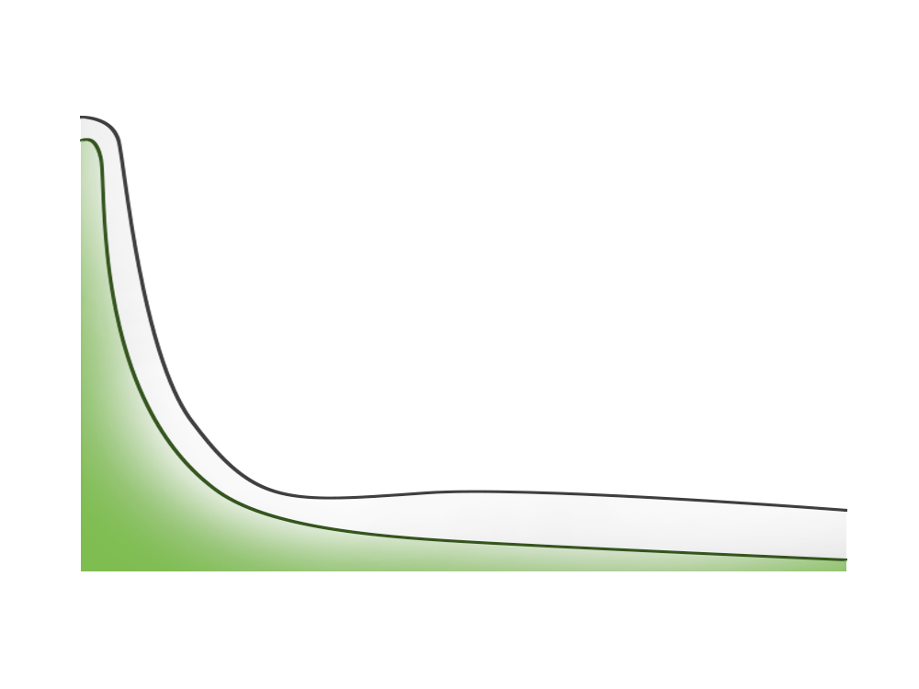
The Partner Opportunity
Managed VARs and Corporate Resellers
~100 partners who produced 50% of our Q2 2012 SMB bookings
# of SMB Customers Per Partner
Long Tail of VAR Community
~5,000 partners who produced the other 50% of our bookings
All SMB Customers
VMware White Space Opportunity
VMware SMB Customers
Partners Rank Ordered by Number of VMware Customers
Most VMware Customers
Fewest VMware Customers

Slide 20
What Kind Of Marketing Programs Do We Run

Slide 21





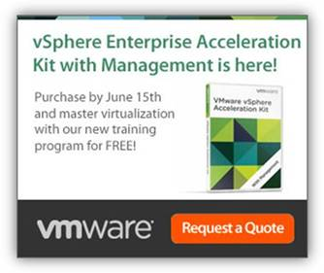
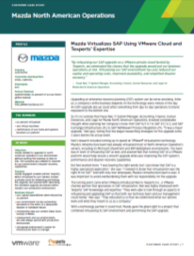
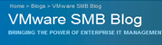

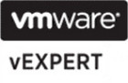


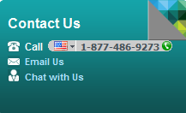
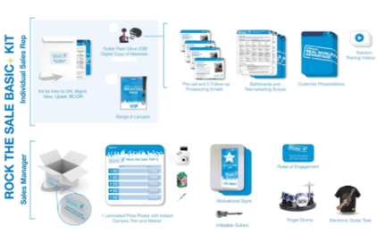


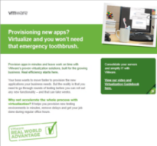

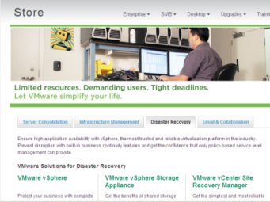
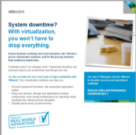
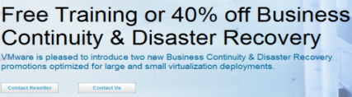
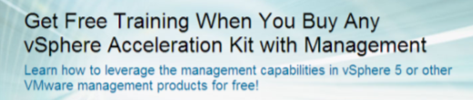
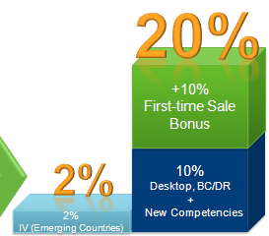
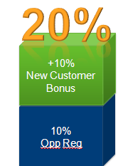
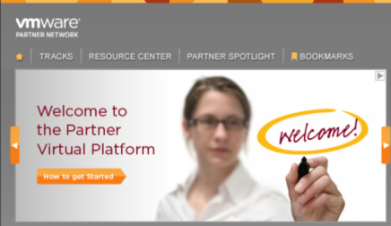




SMB Programs
Insights SMB Customer eMagazine
Issue #1 –3,481 total views
Issue #2 – 15,414 total views (include EMEA edition)
Social Media
Press Byline
Spiceworks RFQ
vExpert and GSS
SMB Magazine
References
Awareness
and Buzz
Video Seeding
Social Media/Communities
126,000 Spiceworks followers
$756k closed to date incremental bookings from EMEA renewals pilot
Demand Gen –VMware/GRID
Real World Advantage (RWA)
Click to Chat
Customer Call Out Days
EMEA Renewal Pilot
Cross-Sell/Up-Sell
VMworld
Customer Programs and Promotions
Web Store
Real World Advantage Campaign
37,323 leads YTD
$68M in Influenced pipe
US expect leads to be up by 42%
EMEA at 124% of sourced pipe contribution
Events
7.5k attendees at VMworld SMB “tagged” top 10 sessions
Email
Nurture
Customer Promotions
Partner Virtual Platform
Regional sales support
Partner Programs
Confidential

Slide 22
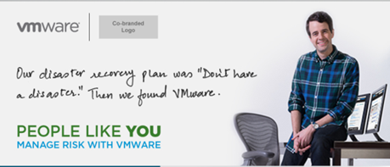
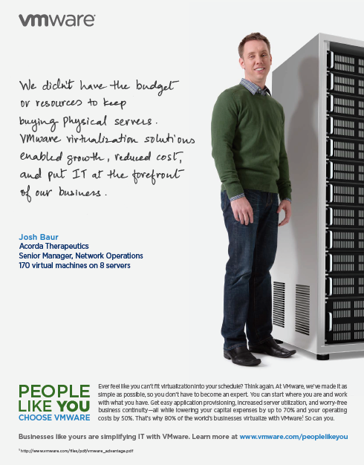
People Like You – Campaign Objectives
Customer – upsell/cross-sell to increase adjacencies penetration: vSOM + EUC + Cloud
Prospects – Support sales goals of acquiring net new customers: vSOM
Drive cloud message for Commercial and S1 SMB segments
Focus on volume deals in SMB and value deals In Commercial + through the channel
Customer: http://info.vmware.com/content/21290_people_like_you_cust_NA_index
Prospects : http://info.vmware.com/content/21289_people_like_you_prosp_NA_index

